Slide 1
Scaling Agile
With Agile Nexus

Slide 2

Scaling Agile
Agile Scrum
Scalability
Agile Nexus
Other Scaling Methods
DAD
SAFe

Slide 3
Scalability
Typical individual team is 7 ± 2 people
Scalability comes from teams of teams
Factors in scaling
Type of application
Team size
Team dispersion
Project duration
Scrum has been used on multiple 500+ person projects

Slide 4
Agile Nexus
Agile Scrum at Scale with multiple teams
Or geographically distributed teams

Slide 5
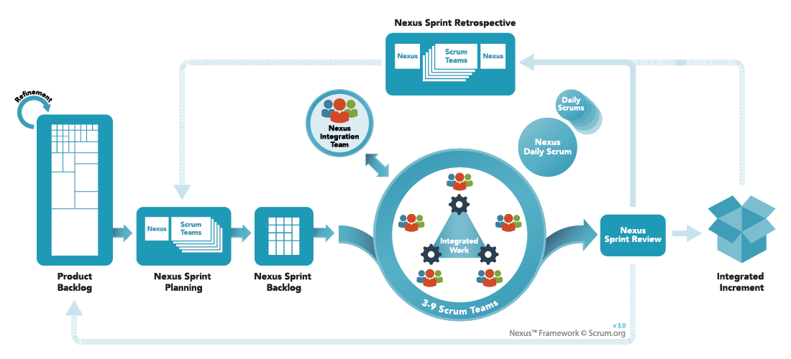
Nexus Expands on Scrum

Slide 6
Nexus Expands on Scrum
6
7
8
3
4
1
2
5

Slide 7
Main Changes – Nexus Sprint Planning
Sprint planning is split into two sections:
A coordination meeting
Big picture discussion, and
Discussion of dependencies between different teams
Includes:
At least one representative of each team (scrum teams and NIT)
Product owner
Meeting takes place right before the actual sprint planning or on the last day of the previous sprint
Goal: coordinate understanding of the product, understanding of interdependencies and understanding of the likely work each team will pick up in the next sprint
Regular sprint planning meeting
Conducted by each team individually
Based on stories selected during the coordination meeting
Stories are still agreed upon within the team
Stories are still sized by the team
Stories can still be rejected by the team
Goal: create a sprint backlog, with full team understanding of the big picture and the goal of the current sprint

Slide 8
Main Changes – Nexus Sprint Backlog
2. The backlog is consolidated across all teams:
Sprint backlog that shows the work of all teams in the current sprint
Very similar to the sprint backlog now used in PS, split by teams
The backlog highlights dependencies between teams
The backlog items clearly demonstrate dependencies between different stories or tasks that cross over onto other teams:
Issues that block / are blocked by
Issues that clone / are cloned by
Issues that duplicate / are duplicated by
Issues that relate to one another

Slide 9
Main Changes – Nexus Daily Scrum
The daily scrum meeting is preceded by a Nexus daily scrum
This takes place before the regular stand up meeting
Representatives of each team participate
Product owner participates
Discussion topics:
Looking at the bigger picture
Are teams integrating well? (this refers to product integration, not people)
Is the product integrating correctly?
Did the nightly build built correctly?
Data from this meeting is used in individual scrum meetings

Slide 10
Main Changes – Nexus Sprint Review
4-5. The Nexus Sprint Review replaces the regular sprint review
The various teams present the different components they have added to the product
The only product being presented is the integrated product increment, not individual team’s product increments, this must be on the final consolidated build.
The outcome of the sprint is the output of all teams
The company / customer looks at the integrated increment

Slide 11
Main Changes – Nexus Sprint Retrospective
6-7. The Nexus Sprint Retrospective is split up into 3 pieces
Before holding a team retrospective:
Representatives of each team get together
Discuss big ticket items (well / improve / puzzles)
Discuss coordination between teams during sprints
Discuss integration issues during sprints
Discuss other issues teams are having
Forms one of the feedback mechanisms for the individual retrospectives
Product owner participates
Regular, individual, team retrospective

Slide 12
Main Changes – Nexus Sprint Retrospective
6-7. The Nexus Sprint Retrospective is split up into 3 pieces
c) Follow up coordination meeting based on outcome of team retrospectives
Representatives of each team participates
Product owner participates
Discuss the outcomes of individual retrospectives that pertain to big picture (do not discuss team internal issues)
Discuss outcomes pertaining to coordination raised in individual teams
Discuss outcomes pertaining to knowledge sharing raised in individual teams
Discuss outcomes pertaining to understanding of the product raised in individual teams
Agree on learnings based on what was shared in each team
Use learnings in individual teams in next sprint

Slide 13
Main Changes – Nexus Integration Team
The Nexus Integration team consists of a separate scrum team
Consists of:
Scrum team
Scrum master
Product owner
Accountable for:
All other teams successfully integrating their product increments
They do not do the integration but manage the integration from a
Technical viewpoint
Communications viewpoint
Effectiveness of process and process improvement viewpoint
Facilitation of integration through coaching and consulting with the teams during sprints
Primary responsible for ensuring integration works well
Accountable for dealing with integration challenges

Slide 14
Unchanged
Since Nexus only has one product backlog there is only one product owner
The roles of scrum masters in teams remains the same
For all Nexus meetings, representatives of all teams participate (including NIT)
For Nexus meetings, product owner participation is mandatory
Velocity is tracked by team, not consolidated
NIT works as any other agile team (but usually works in Kanban rather than scrum)

Slide 15
Other Scaling Methods
Agile Scrum at Scale with multiple teams
Or geographically distributed teams

Slide 16
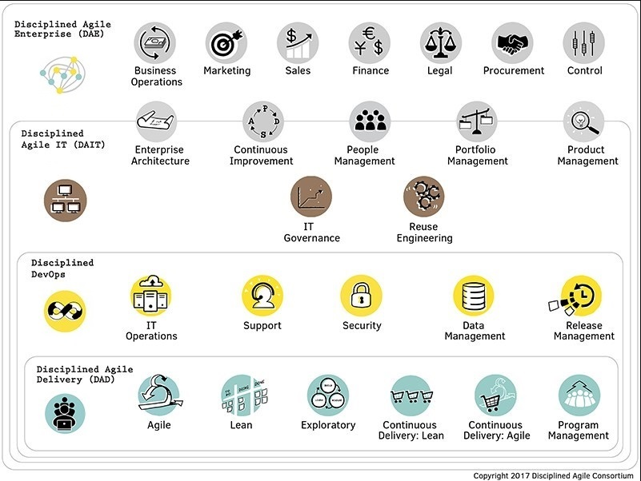
Disciplined Agile

Slide 17
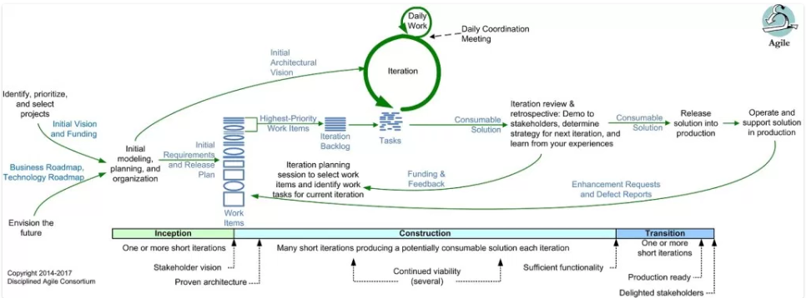
Disciplined Agile

Slide 18
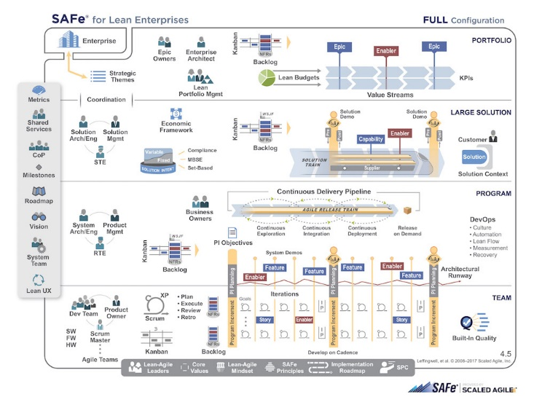
Scaled Agile Framework (SAFe)

Slide 19
Additional Information
Agile Scrum
More Information
Suggested Reading

Slide 20
More Information
Agile:
https://www.scrumalliance.org/ - Agile Scrum
www.agilemanifesto.org/ - The Agile Manifesto
http://agilemethodology.org/ - Agile Scrum
https://www.agilealliance.org/ - Agile Scrum
http://disciplinedagiledelivery.com/ - D.A. 2.0
https://www.mountaingoatsoftware.com// - Agile Scrum
https://www.atlassian.com/agile/kanban/ - Agile Kanban
http://www.scaledagileframework.com/ - SAFe
www.mountaingoatsoftware.com/scrum - Agile Scrum
www.controlchaos.com
https://www.scrum.org/resources/nexus-guide - Agile Nexus
https://www.scrum.org/resources/scaling-scrum - Agile Nexus

Slide 21
More Information
User Stories:
https://agilefaq.wordpress.com/2007/11/13/what-is-a-story-point/
https://www.scrumalliance.org/community/articles/2012/august/story-points-versus-task-hours
https://www.scrumalliance.org/community/spotlight/mike-cohn
http://www.romanpichler.com/blog/10-tips-writing-good-user-stories/
https://www.scrumalliance.org/community/articles/2014/march/stories-versus-themes-versus-epics
http://searchsoftwarequality.techtarget.com/definition/user-story
http://agileforall.com/new-to-agile-invest-in-good-user-stories/
http://ronjeffries.com/xprog/articles/expcardconversationconfirmation/
https://www.mountaingoatsoftware.com/uploads/articles/User-Stories-Applied-Mike-Cohn.pdf
http://www.romanpichler.com/blog/epics-and-ready-stories/
https://help.rallydev.com/writing-great-user-story
http://www.agilemodeling.com/artifacts/userStory.htm
https://www.scrumalliance.org/community/articles/2013/september/agile-user-stories
http://www.boost.co.nz/blog/2010/09/acceptance-criteria/
http://nomad8.com/acceptance_criteria/
http://www.seguetech.com/blog/2013/03/25/characteristics-good-agile-acceptance-criteria
https://www.mountaingoatsoftware.com/agile/user-stories
/june-2014/how-many-hours-is-a-story-point-worth

Slide 22
Reading List
Agile and Iterative Development: A Manager’s Guide by Craig Larman
Agile Estimating and Planning by Mike Cohn
Agile Project Management with Scrum by Ken Schwaber
Agile Retrospectives by Esther Derby and Diana Larsen
Agile Software Development Ecosystems by Jim Highsmith
Agile Software Development with Scrum by Ken Schwaber and Mike Beedle
Scrum and The Enterprise by Ken Schwaber
Succeeding with Agile by Mike Cohn
User Stories Applied for Agile Software Development by Mike Cohn

